Slide 1
Business Engineering
Engineering
subfield
Business Engineering
Complex in nature. So, how to manage.
No core market. Hence, opportunities to be created with the help of engineering.
Supply market- output of business engineering change known forms of supply.

Slide 2
Business Economics
How your money matter work?
Surrounding environment
(external matters like economic issues)
Business
Money matters
Internal matters-
Expansion
Diversification
Relationship between employees and their firm

Slide 3
Nature and Scope of Economics
Economics studies-
1. Production- what to produce & in what quantity because there is scarcity.
2. Distribution- of goods and services to satisfy his (human) bundle of desires.
3. consumption
Macro and Micro economics- what actually is the condition
Normative economics- what ought to be the condition

Slide 4
Types of economic systems
Socialist- guided by market forces. Also known as laiseez fair economy.
Capitalist- opposite to socialist
Mixed Economy

Slide 5
Differences
Macro Economics
Micro Economics
‘Macro’ means large.
It is a study of economy as a whole.
It deals with aggregate of these quantities. Eg. national income, price level, national output.
Objectives of macroeconomics are full employment, price stability, economic growth, favourable balance of payments etc.
It is a dynamic analysis.
The word ‘Micro’ means small.
It is a study of individuals or groups. According to Shapiro “Microeconomics deals with small parts of the economy.”
It is a study of particular households, particular firms, particular industries, particular commodities, particular prices etc.
The objective of microeconomics is to maximize utility or maximization of profit or minimization of cost.
It is a static analysis

Slide 6
Engineering efficiency and Economic efficiency
Engineering efficiency happens when there is no possibility to increase the output without increasing the input.
Economic efficiency happens when the production cost of an output is as low as possible.
Engineering efficiency is really a prerequisite for economic efficiency. In order to achieve economic efficiency, one should have achieved Engineering efficiency.
An economic efficiency is a state in which every resource is made use of to serve each person in the very best way while minimizing inefficiency and waste.
Once there is economic efficiency, any change that is made to assist any person is likely to harm others.
Economic efficiency mainly depends on the prices related to the factors of production. Engineering efficiency is considered an engineering matter.

Slide 7
ECONOMICS-Definition
Oikos + Nemein
Oikos = Household
Nemein = To manage
To manage limited recourses from households' perspective, is known as economics.
Ms and Ts of Management
Men, Machine, Material, Money, Market
Time and Technology

Slide 8
Consumer Demand Analysis
Demand- It is the quantity of commodity an individual consumes.
It is possible with the help of desire and purchasing power.

Slide 9
Law of demand
Price 1/ Quantity demanded
If taste, preference of consumer, income remain constant.
Reason for applicability of Law of demand-
Substitute effect- price falls, purchasing power rises
Income effect- price rises, purchasing power falls

Slide 10
Exceptions to law of demand
Goods used as status symbol
Speculative activities in market like stock, gold, land etc.
Giffen goods- steple food( basic food). In Ireland, potato is considered as steple food.
Inferior Goods- lower quality of wheat, rice etc.

Slide 11
Demand curve

Slide 12
Law of diminishing marginal utility
The law of diminishing marginal utility is a law of economics stating that as a person increases consumption of a product while keeping consumption of other products constant, there is a decline in the marginal utility that person derives from consuming each additional unit of that product.

Slide 13
Factors affecting demand/ Demand Function
Qdx = f (PX, I, PY, T)
Where,
PX = Price of Product
I= Income of consumer
PY= Price of related good
T= Taste of consumer

Slide 14
Different curves for various type of goods
Substitute goods and Inferior/superior goods
Complimentary goods and Giffen goods

Slide 15
Horizontal summation of individual demand curve is market demand curve.
When total demand is shown with price, it is total demand or market demand.
The tabular form of the above is called as market demand schedule.

Slide 16
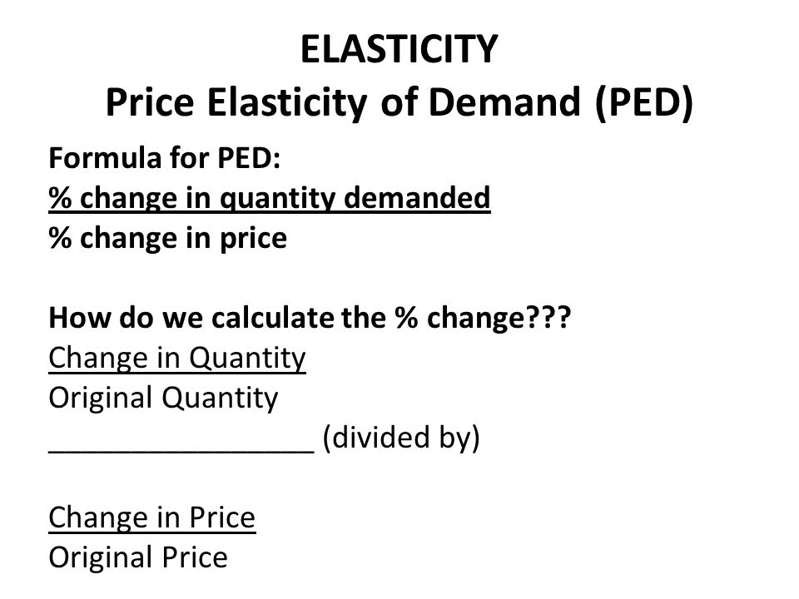
Elasticity of demand
% change in quantity demanded due to various factors.

Slide 17
Types of PED

Slide 18
Where,
Unitary elastic demand= No example
Relatively elastic demand= luxurious goods
Relatively inelastic demand= products of necessity
Perfectly inelastic demand= common salt
Perfectly elastic demand= No example

Slide 20
Income elasticity of demand

Slide 21
Promotional elasticity of demand

Slide 22
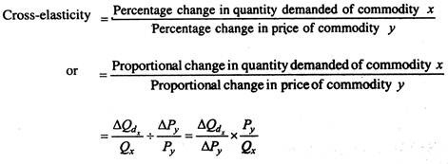
Cross Elasticity of demand

Slide 23
Numerical
If for a company, Elasticity of Demand is -8.64. What should company does to increase the sale on profit?
a) Company should increase the price.
B) Company should decrease the price.
Sol:- Ed= 8.64 (Ed>1) Relatively Price
So, decrease the price to boost the quantity demanded.

Slide 24
The demand for apples in a town was 200 KGs when price was Rs. 20 per KG. It expanded to 250 KGs when price was reduced to Rs.18 per KG. Calculate Ed for apples in the town.
Sol:- Ed= dQ/dP *P/Q
dQ= 250-200= 50
dP= 20-18= 2
50/2 *20/200= 2.5 (Ed>1) Luxury goods

